Slide 1
INTRODUCTION TO DEEPLEARNING
Deep learning algorithms use ANNs (short for Artificial Neural Networks) to duplicate the functioning of our brain. Why though? Not trying to be philosophical or historical, but our brain is the most complicated piece of machinery we know.
1

Slide 2
How an algorithm processes and computes the output is of course different from another algorithm. For example, in one type of algorithm MLPs, the data is processed by the stacking the basic form of neural networks (also called a perceptron) on top of each other and at different levels. The data is divided
2

Slide 3
between these sections, processed, and an output or multiple outputs are generated.
. Convolutional Neural Networks (CNNs)
. Recurrent Neural Networks (RNNs)
. Long Short-Term Memory Networks (LSTMs)
. Multilayer Perceptrons (MLPs)
. Radial Basis Function Networks (RBFNs)
3

Slide 4
. Generative Adversarial Networks (GANs)
. Deep Belief Networks (DBNs)
. Self-Organizing Maps (SOMs)
. Autoencoders
. Restricted Boltzmann Machines (RBMs)
Understanding the Basic Structure
Artificial Neural Networks are inspired by the way the human brain processes information. At their core, ANNs are made up of interconnected nodes, much
4

Slide 5
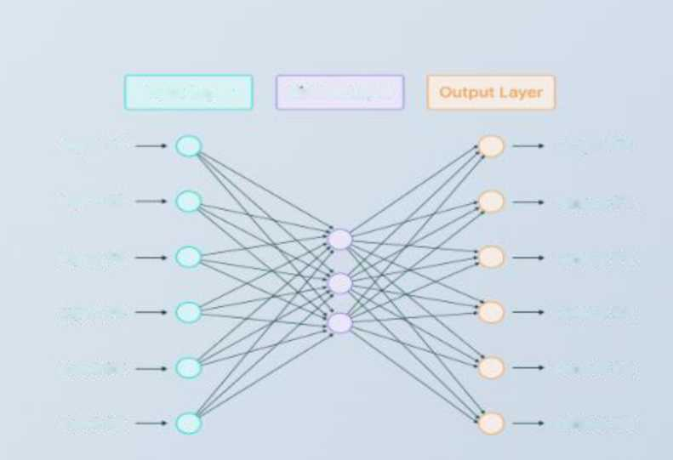
like neurons in the human brain. These nodes, also known as artificial neurons or perceptrons, are organized into layers: an input layer, one or more hidden layers, and an output layer. Let's visualize this:
Input Layer Hidden Layer
Input n 1
Output #1
Input #2
Output #2
Input ft 3
Output #3
Input ft4
Output ft4
Input ftS
Output #5
Input #6
Output ft6
5

Slide 6
. Input Layer: This is where the ANN receives its initial data. Each node in the input layer represents a feature or attribute of the input data.
. Hidden Layers: These layers perform the heavy lifting of computation. Neurons in the hidden layers process the input data and progressively extract higher-level features.
. Output Layer: The final layer produces the ANN's output, which might be a classification,
6

Slide 7
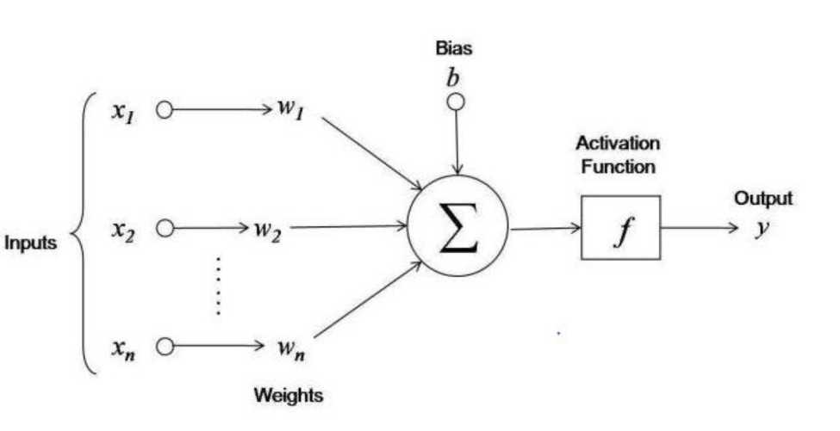
prediction, or some other form of decision.
Neurons: The Building Blocks
To dive deeper into the workings of a neural network, let's focus on a single artificial neuron.
7

Slide 8
. Input Weights (w1, w2, w3): Each input is assigned a weight, representing its importance in the computation. These weights are adjusted during training to optimize the model.
. Activation Function (a): The
weighted sum of inputs is passed through an activation function. Common activation functions include the sigmoid, ReLU (Rectified Linear Unit), and tanh functions, which
8

Slide 9
introduce non-linearity into the model.
. Output (y): The activation function produces the output of the neuron, which is then passed to the next layer.
How ANNs Learn: Training with Backpropagation
The power of ANNs lies in their ability to learn from data. They adjust their weights to minimize the difference between their predicted output and the actual target.
9

Slide 10
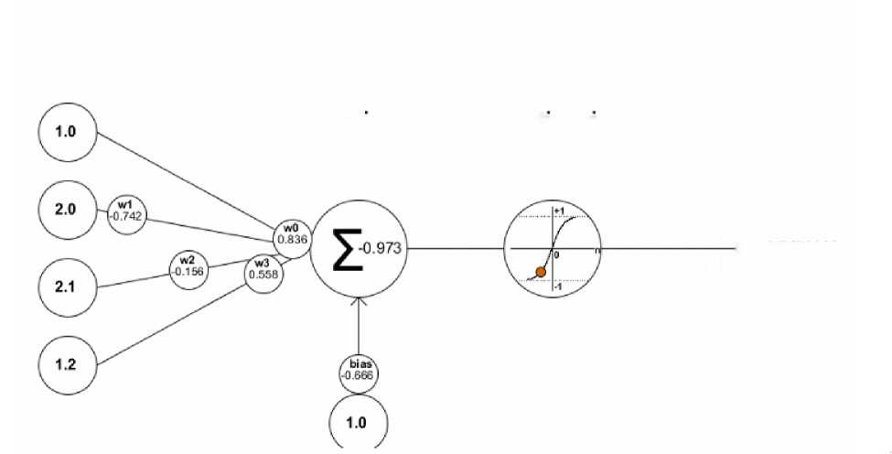
Inputs
Weights
Net input
Activation
funtion
funtion
output
> -0.7472868
Here's a step-by-step explanation:
1. The input data is fed forward through the network, producing a prediction.
2. The error, or the difference between the prediction and the actual target, is calculated.
10

Slide 11
3. The error is then propagated backward through the network to adjust the weights. This process continues for multiple iterations, fine-tuning the network’s performance.
Convolutional Neural Networks
Working: They have multiplayer layers that process the features from the data.
11

Slide 12
These networks are mostly used for detecting objects and processing images.
Important layers that carry out the output:
Convolutional Layer: The
layer has multiple filtering operations that carries out complex operations.
12

Slide 13
Rectified Linear Unit: Also called ReLU for short. This unit applies some operations on the elements and outputs a rectified feature map.
Pooling Layer: Output of ReLU goes into this Pooling Layer. Pooling is done to reduce the dimensionality of the feature map.
13

Slide 14
The pooling layer outputs a single long vector from the 2-D output of ReLU.
If we are using CNNs for image classification, for example, then in the end, after pooling is done, the vector from pooling layer goes into a feed forward network or a fully connected
14

Slide 15
layer which will classify the images.
Recurrent Neural Networks (RNNs) utilize their outputs as inputs, allowing them to retain information from prior inputs. This characteristic enables RNNs to execute potent operations on data by leveraging their memory of past inputs. The
15

Slide 16
self-feeding property of RNNs also permits them to unfold over time, signifying that the output at one time step (t1) can differ from the output at another time step (t2).
Used for:
. Image Captioning
. NLP (Natural Language Processing)
. Time Series Analysis
16

Slide 17
. Language Translation
Long Short-Term Memory Networks (LSTMs)
These are a type of RNNs that has the default behaviour of recalling past information (sounds human enough!) for quite long periods.
The use cases of LSTMs are very similar to RNNs but more specifically, they can be used for music composition, speech recognition, etc.
17

Slide 18
Working of an LSTM is carried out in three steps:
. Forget the unnecessary information of the past state.
. Update the current cell values.
. Output the certain state of the cell.
Mutlilayer Perceptrons (MLPs)
If you know about the perceptron, then you would have guessed how this algorithm work just from reading the title.
18

Slide 19
They contain various perceptrons with activation functions stacked vertically and connected horizontally.
MLPs are used for speech-recognition, translation, and speech-recognition.
So, those were the most popular neural network algorithms. If you want to know more in detail about the networks described above, and the others.
What is Activation Function?
It’s just a thing function that you use to get the output of node. It is also known as Transfer Function.
19

Slide 20
Why we use Activation functions with Neural Networks?
It is used to determine the output of neural network like yes or no. It maps the resulting values in between o to 1 or -1 to 1 etc. (depending upon the Junction).
The Activation Functions can be basically divided into 2 types-
1. Linear Activation Function
2. Non-linear Activation Functions
FYI: The Cheat sheet is given below.
Linear or Identity Activation Function
As you can see the function is a line or linear. Therefore, the output of the functions will not be confined between any range.
20

Slide 21
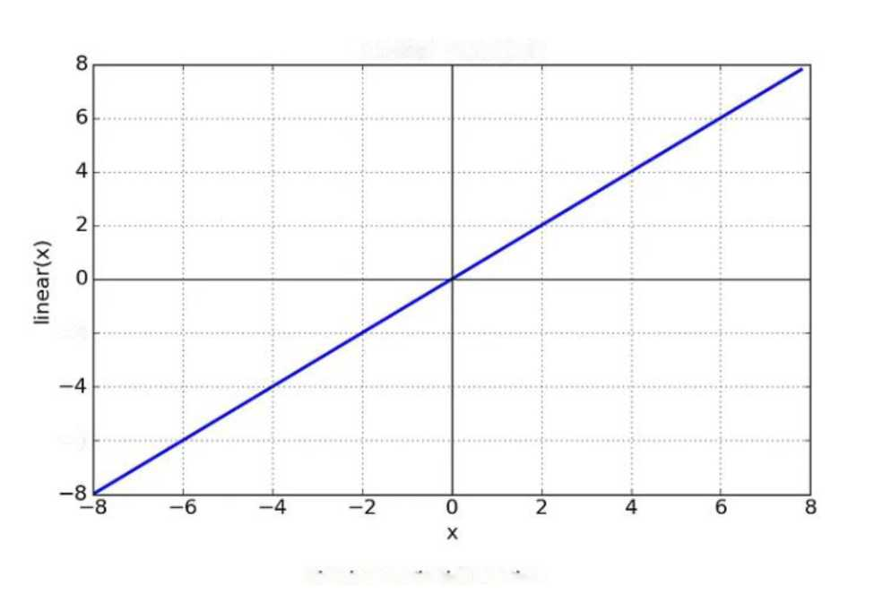
Linear Function
-2
-6
Fig: Linear Activation Function
Non-linear Activation Function
The Nonlinear Activation Functions are the most used activation functions. Nonlinearity helps to makes the graph look something like this
21

Slide 22
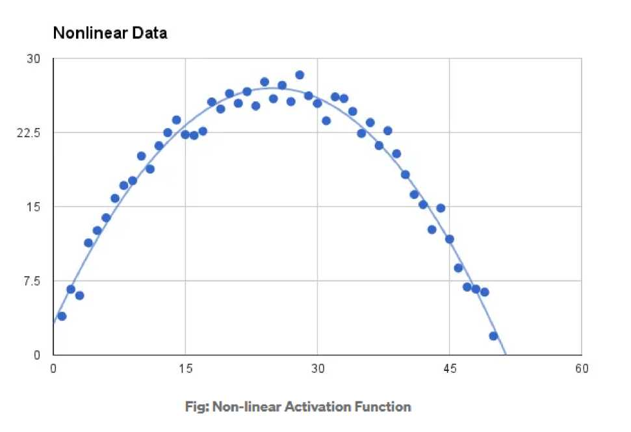
It makes it easy for the model to generalize or adapt with variety of data and to differentiate between the output.
The main terminologies needed to understand for nonlinear functions are:
Derivative or Differential: Change in y-axis w.r.t. change in x-axis.It is also known as slope.
Monotonic function: A function which is either entirely nonincreasing or non-decreasing.
22

Slide 23
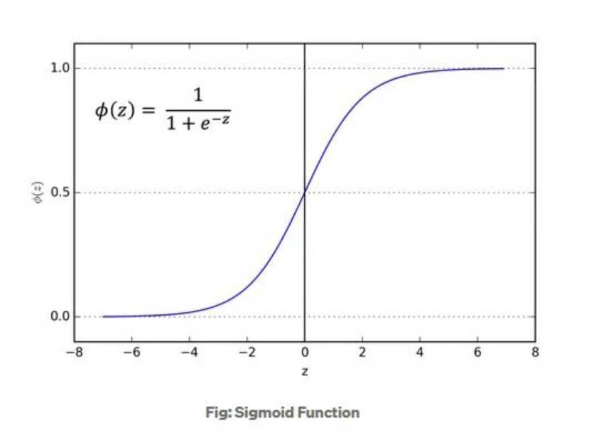
The Nonlinear Activation Functions are mainly divided on the basis of their range or curves
1. Sigmoid or Logistic Activation Function
The Sigmoid Function curve looks like a S-shape.
The main reason why we use sigmoid function is because it exists between (o to 1). Therefore, it is especially used for models where we have to predict the probability as an output.Since probability of anything exists only between the range of 0 and 1, sigmoid is the right choice.
23

Slide 24
The function is differentiable.That means, we can find the slope of the sigmoid curve at any two points.
The function is monotonic but function’s derivative is not.
The logistic sigmoid function can cause a neural network to get stuck at the training time.
The softmax function is a more generalized logistic activation function which is used for multiclass classification.
2. Tanh or hyperbolic tangent Activation Function
tanh is also like logistic sigmoid but better. The range of the tanh function is from (-1 to 1). tanh is also sigmoidal (s - shaped).
24

Slide 25
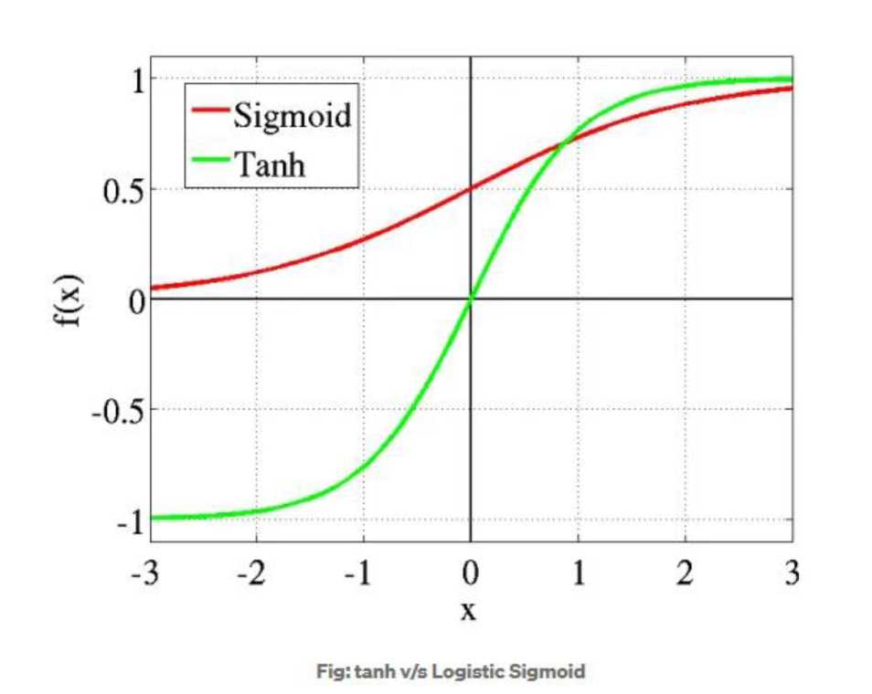
The advantage is that the negative inputs will be mapped strongly negative and the zero inputs will be mapped near zero in the tanh graph.
The function is differentiable.
The function is monotonic while its derivative is not monotonic.
The tanh function is mainly used classification between two classes.
25

Slide 26
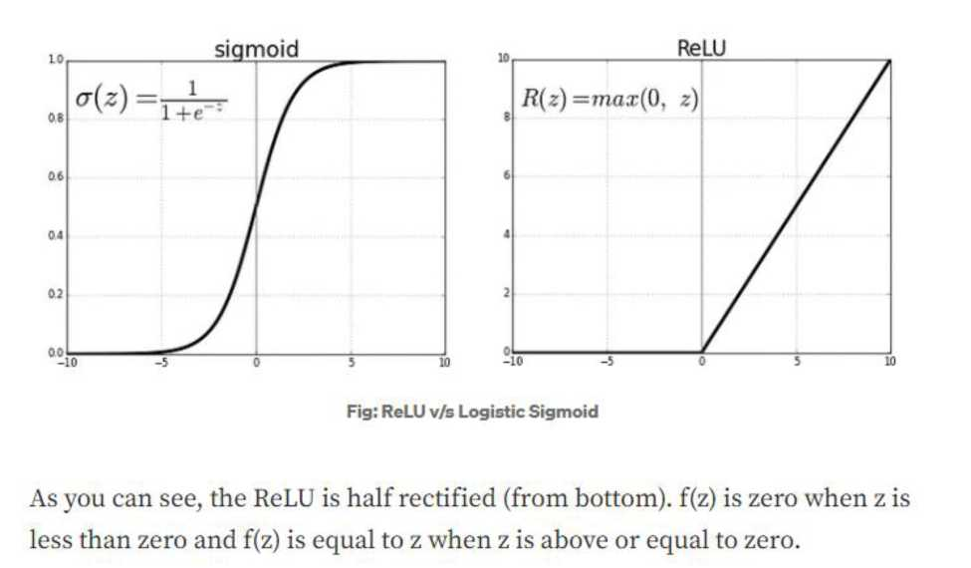
Both tank and logistic sigmoid activation functions are used in feedforward nets.
3. ReLU (Rectified Linear Unit) Activation Function
The ReLU is the most used activation function in the world right now.Since, it is used in almost all the convolutional neural networks or deep learning.
Range: [ 0 to infinity)
The function and its derivative both are monotonic.
But the issue is that all the negative values become zero immediately which decreases the ability of the model to fit or train from the data properly. That means any negative input given to the ReLU activation
26

Slide 27
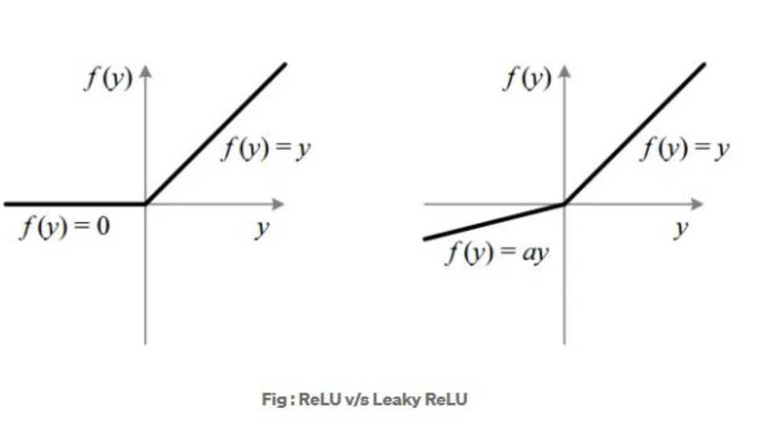
function turns the value into zero immediately in the graph, which in turns affects the resulting graph by not mapping the negative values appropriately.
4. Leaky ReLU
It is an attempt to solve the dying ReLU problem
The leak helps to increase the range of the ReLU function. Usually, the value of a is 0.01 or so.
When a is not 0.01 then it is called Randomized ReLU.
Therefore the range of the Leaky ReLU is (-infinity to infinity).
27

Slide 28
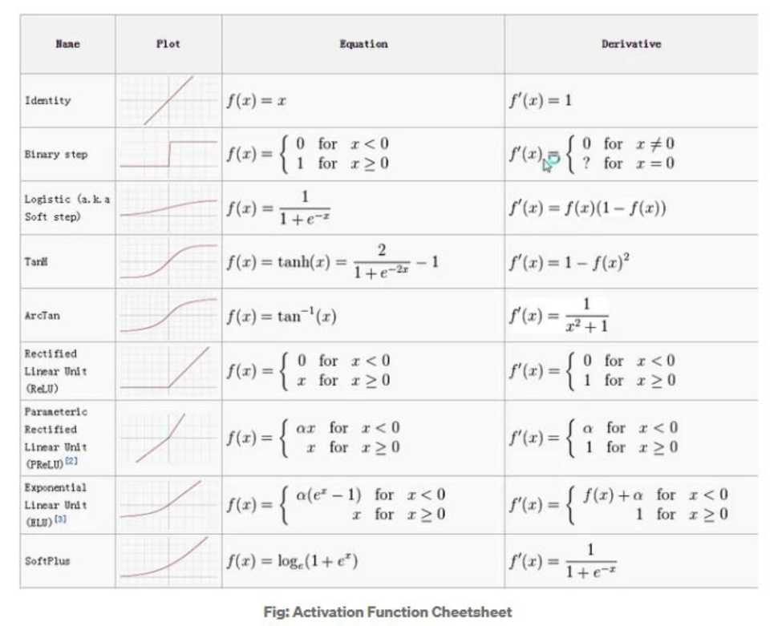
Both Leaky and Randomized ReLU functions are monotonic in nature. Also, their derivatives also monotonic in nature.
Why derivative/differentiation is used ?
When updating the curve, to know in which direction and how much to change or update the curve depending upon the slope.That is why we use differentiation in almost every part of Machine
Learning and Deep Learning.
28

Slide 29
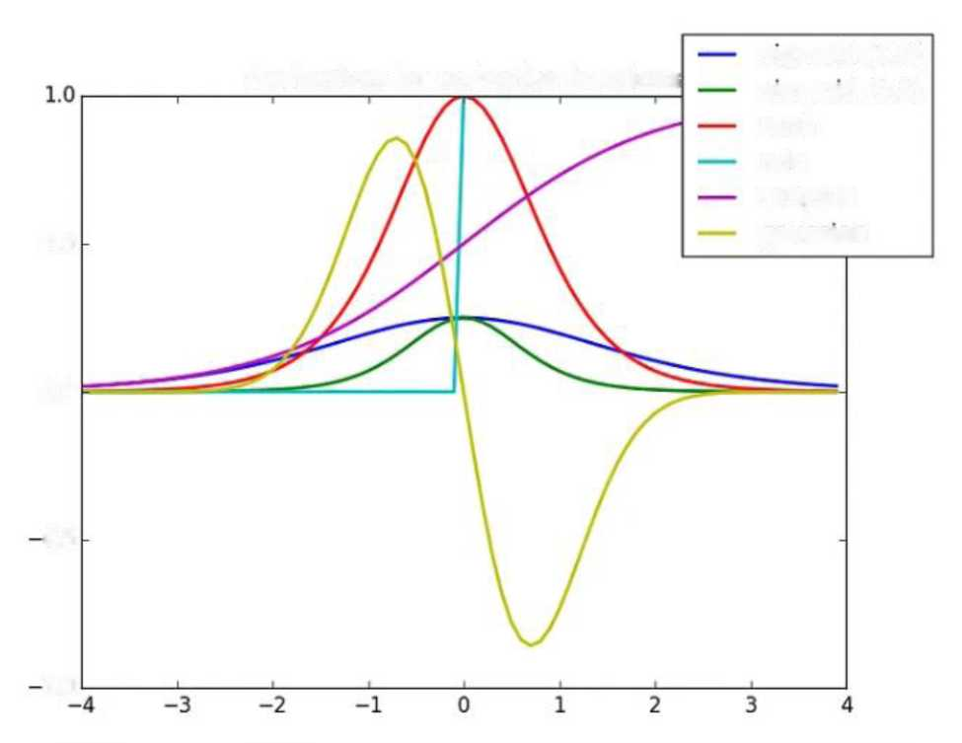
Derivatives for activation functions
sigmoid (1.0)
sigmoid (2.5)
tanh
relu
softplus
0.5
gaussian
0.0
0.5
1.0
1 import sys
2 impor numpy as rip
3 i; matplotlib
4
5
6 print(“Python:", sys.version)
7 print("Numpy, np. version )
8 print(“Matplotlib: ", matplotlib. version )
But part the problem with learning deep learning is people use the same 3-4 words
29

Slide 30
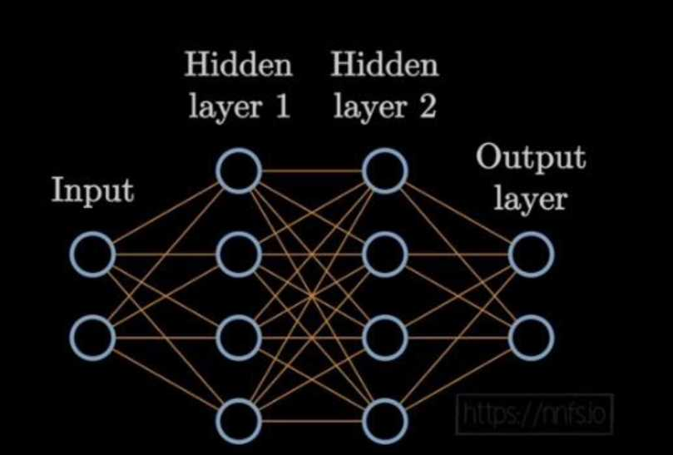
inputs - (1.2, 5,1, 2.11 weights - [3.1, 2.1, 0.7] bias 3
is to add up all the inputs times weights plus the bias
output inputs[QJ weights[0] inputsfi] weights[l] inputs[2] weights[2( bias print(output]
30

Slide 31
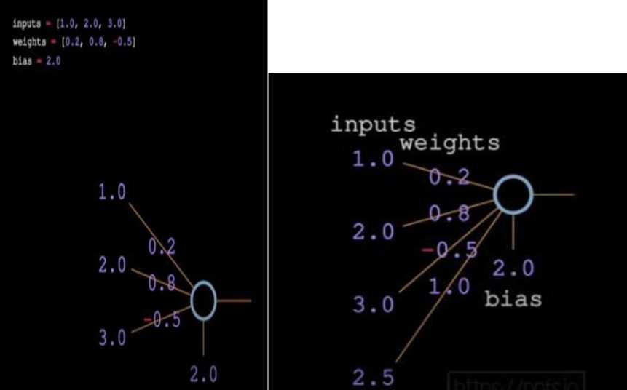
inputs [1, 2, 3, 2.3) |  | & ♦♦
3 weights! (0.2. 0 8. 93, 1.0)
4 welghts2 (0.3. 0.91, 0.20, 0. | 31
weights3 | 0 26, 8 27. 6 17, 0 | 87)
7 biasl 2 8 bias? 3 9 bias! ■ 0.3
11 output |lnputs{6) weightsl(e) | inputs(l) weighlslfl] | inputs]?] weightsl[2] ■ | inputs]!] | weightsl]3] | bias}.
lnputsioj weights2[o) | Inputs]1| welghts2]lj | inputs]2) weights2[?j | inputs]J) | weights2(11 | bias2,
Inputs|0| weights3(0) 14 print(output) | inputs]1) weights3|lj | inputs]2)'weights3[2) | inputs]3] | weights3(3] | bias^l
4.8. 1.21. 2.385] iFinished in e.esj
31

Slide 32
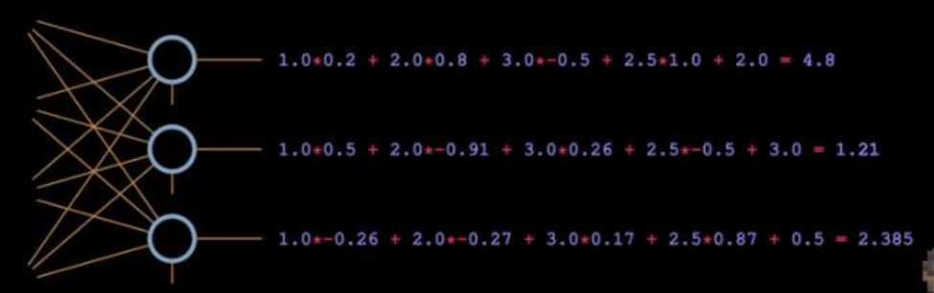
inputs 1 - O
30
2.0 3 . O 2.5
x^O
/ \y\
o
inputs [1, 2. 3, 2.5J
weights 116.2. 6.8. 0.5. 1.6),
16.5, 6.91, 6.26, 6.5],
[ 6.26, 6.27. 6.17. 6.87)1
biases [2, 3. 6.5)
layer outputs I]
neuron weights, neuron bias zip(weights, biases): neuron output 6
n input, weight zip(inputs, neuron weights):
neuronoutput ninput weight neuron output * neuron bias layer outputs.append(neuron output)
print(layer outputs)
32

Slide 33


inputs [1. 2
$ Neural Networks from Scratch X +
weightsl |0.2, _
welghts2 to 5. <] CP Q nnfs.io
weights! ( 8.2€
blast 2 bias2 3 bias! 0.5
Neural Networks from Scratch PREORDER
output [inputs!
inputsl inputs! print(output)
Start by programming ndnndud neurons
EB Q~
W ttwv ectiMtionKnctioNa
• Sipmt
• Law
Learn how loss works and how to catcuiate loss with Cross-Entropy
Naral Net worts from Scratch n Python
, 2.385 nished in e.esl
Cede and perform gradw* computet
33

Slide 34
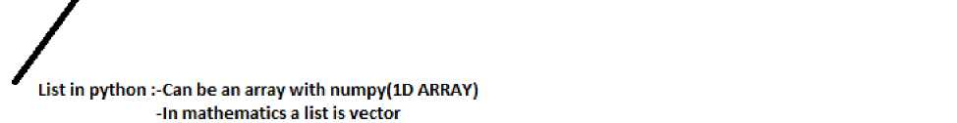
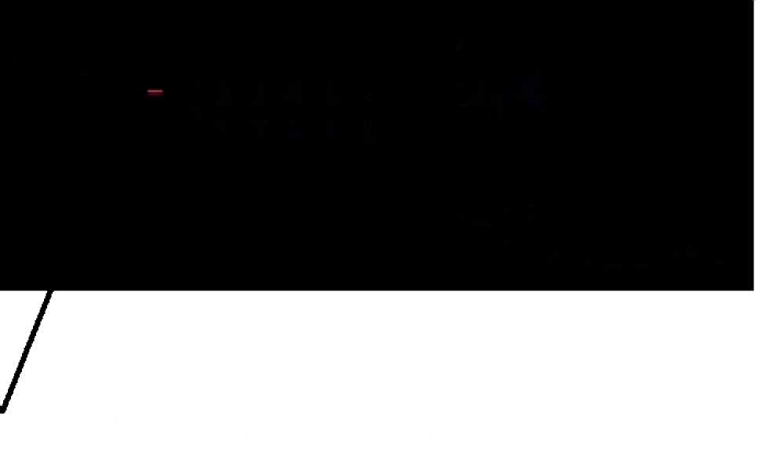
Shape
Array : | Shape :
1 = [1,5,6,2] | (4,)
 | Type :
 | ID array, Vector
Array : |  | Shape :
lol = | [[1,5,6,2], | (2, 4)
 | [3,2,1,3] ] | Type :
 |  | 2D Array, Matrix
List contanining two list:-In python is called list of lists
-In numpy it is two dimensional array(2D Array) -Its also a matircs which is rectangular array
34

Slide 35
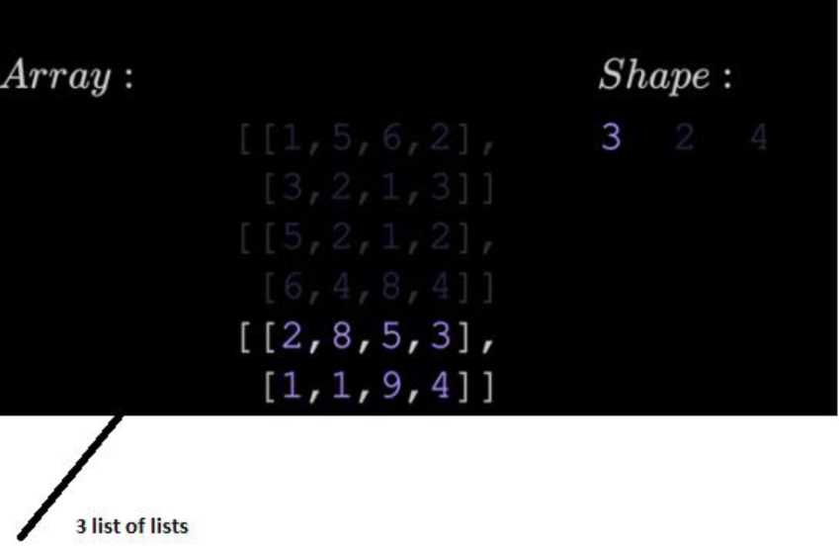
Array :
lolol = [[[1,5,6,2],
[3.2.1.3] ]
[ [5,2,1,2],
[6.4.8.4] ], [[2,8,5,3],
[1.1.9.4] ]]
Shape :
(3, 2, 4)
Type :
3D Array
-Frist at the first dimension we have 3 elements -Second dimesnion we have 2 elemenst -Third dimension we have 4 elements
35

Slide 36
The last container is a tensor: A tensor is an object that cane repented as an array, it is not an array but context of doing deep learning and programming, a tensor is represented as an array.
inputs
weights I[0.2, 0.8, 0.5, 1.01,
[0.5, 0.91, 0.26, 0.51,
[ 0.26, 0.27, 0.17, 0.87U
Matrix of vectors
biases (2. 3. 0.51
How to multiply those vectors with matrix? (We use DOT PRODUCT)
36

Slide 37
-All the matrix products are in terms of NumPy are dot products
Dot. Products
Is element wise multiplication and add up together.
3L = | [ 1 , 2, | 3]
fc> = | [2, 3, | 4 ]
dot. >>> | _produc 20 | t = a [ O ] *k> [ O ] -+- a [ 1 ] *fc> [ 1 ] + a [ 2 ] * fc> [ 2 ]
a - b | = [1,2,3] | •[2,3,4] = l- 2 + 2- 3 + 3- 4= 20
N.B :Dot product of vectors is scalar single value
37

Slide 38
inputs - [1.0, 2.0, 3.0, 2.5] weights - [0.2, 0.8, -0.5, 1.0] bias » 2.0
outputs * np.dot(weights, inputs) + bias
DOT PRODUCTS OF LAYERS OF 3NEURONS
inputs ■ | [1.0, 2.0, 3.0, 2.5]
weights | - [[0.2, 0.8, -0.5, 1.0]
 | [0.5, -0.91, 0.26, -0.5], [-0.26, -0.27, 0.17, 0.87]]
biases • | [2.0, 3.0, 0.5]
outputs | ■ np.dot(weights, inputs) + biases
inputs | • f1 0- 2 | .0, 3.0, 2.5]
weight | s = [[0.2, | 0.8, -0.5, 1.0)
 | [0.5, | -0.91, 0.26, -0. | 5),
 | [-0.2 | 6, -0.27, 0.17, 0 | .87)]
biases | - [2.0, 3 | .0, 0.5]
output | s - np.dot | (weights, inputs) | ♦ biases
np.dot | (weights, | inputs) » [np.dot | (weights[0], inputs),
np.dot | (weights [ 1 | ], inputs), np.do | t(weights[2), inputs)]
* l* | 9 X
38

Slide 39
outputs ^ np.dot(weights, | inputs) | + biases
>>> array ([..
np.dot(weights, inputs) + | biases ■
(2.8, -1.79, 1.885) ♦ [2.C | ), 3.0, 0 | .5) - (4.8, 1.21, 2. | 385)
Input data : batch =
Shape :
(8, 4)
[[1, | 5/ | 6, | 2),
[3, | 2, |  | 3] f
(5, | 2, | X § | 2),
(6, | 4, | 8/ | 4],
[2, | 8, | 5, | 3 ] /
(If | 1, | 9, | 4) /
[6, | 6, | Of | 4]f
(8, | ' t | 6, | 4]]
Type :
2D Array, Matrix
Weight matrix equation
39

Slide 40
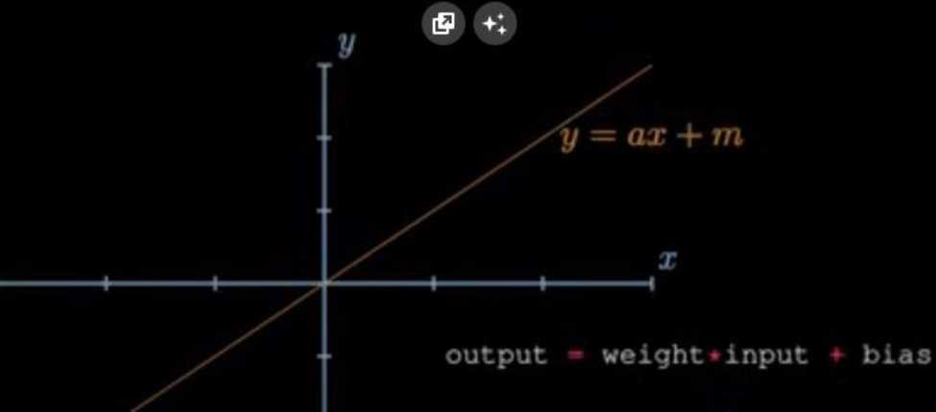
weight
input —o— output
bias
 | n | y /
 |  | weight = | 1.09
 |  | 1 bias = | 0.00
 |  | / X
s' i |  | \ output — weight • input | + bias
40

Slide 41
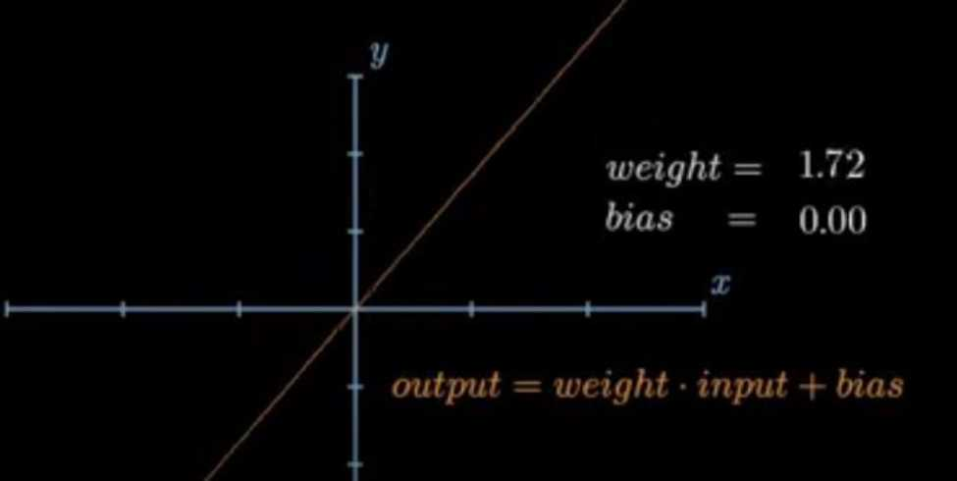
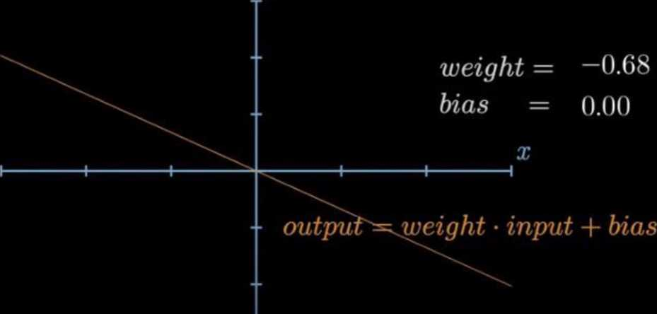
y
41

Slide 42
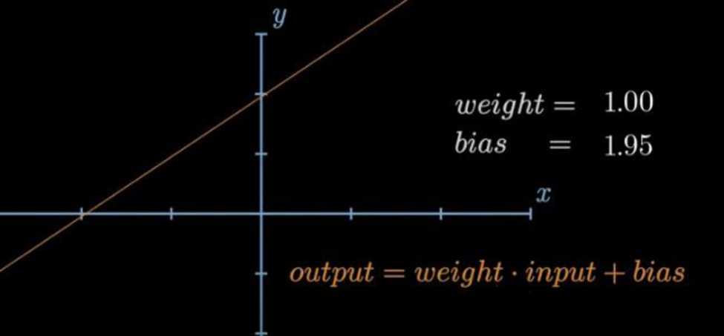
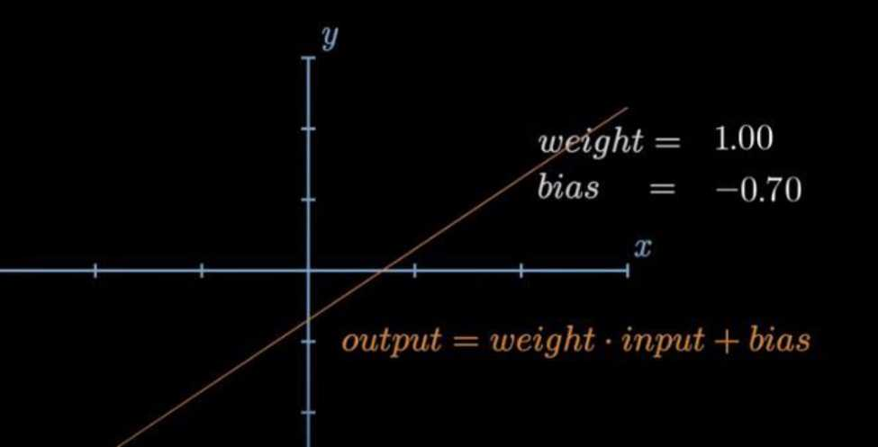
42

Slide 43
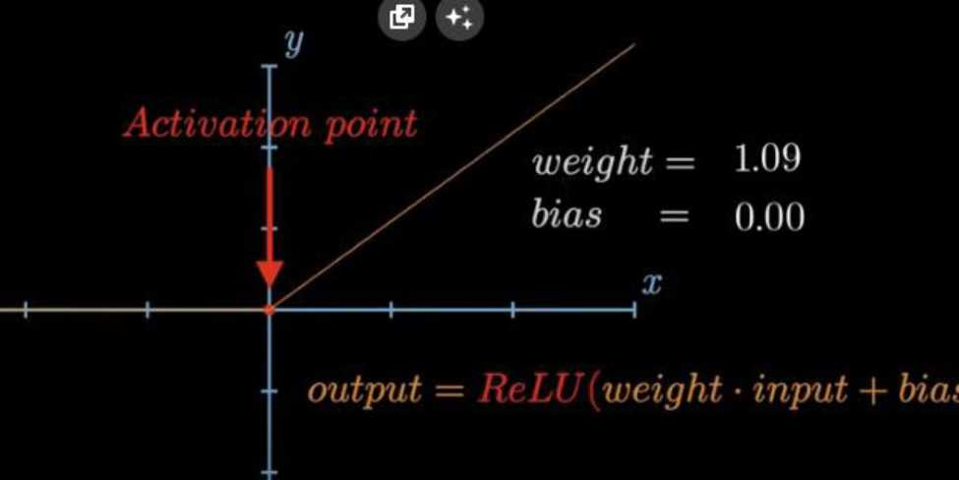
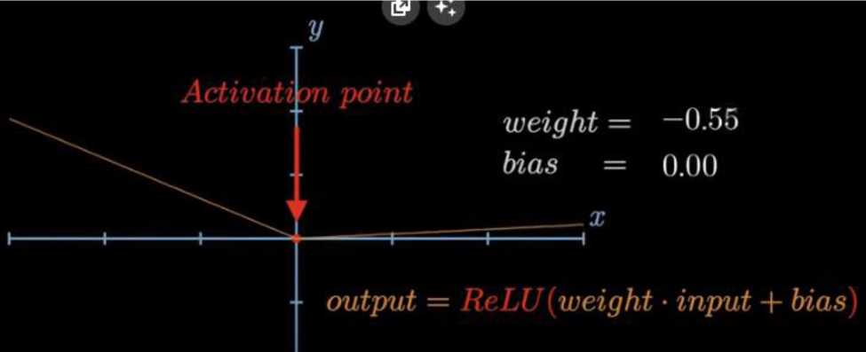
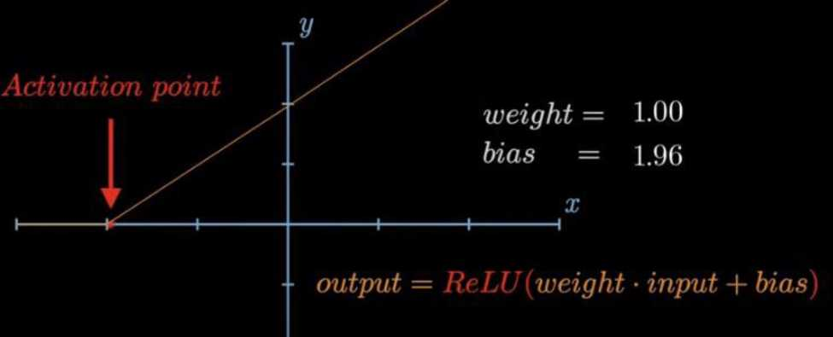
43

Slide 44
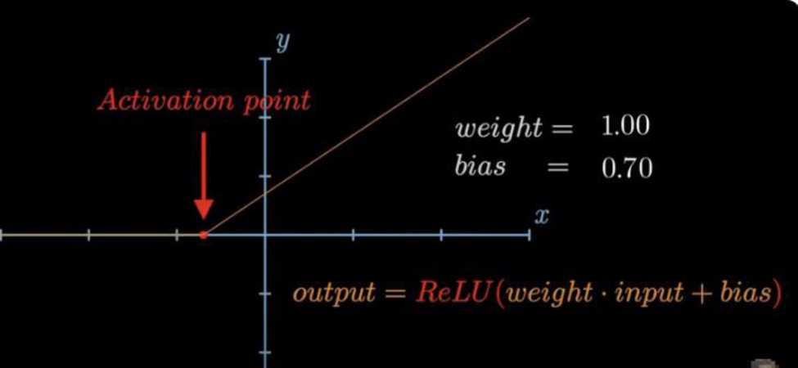
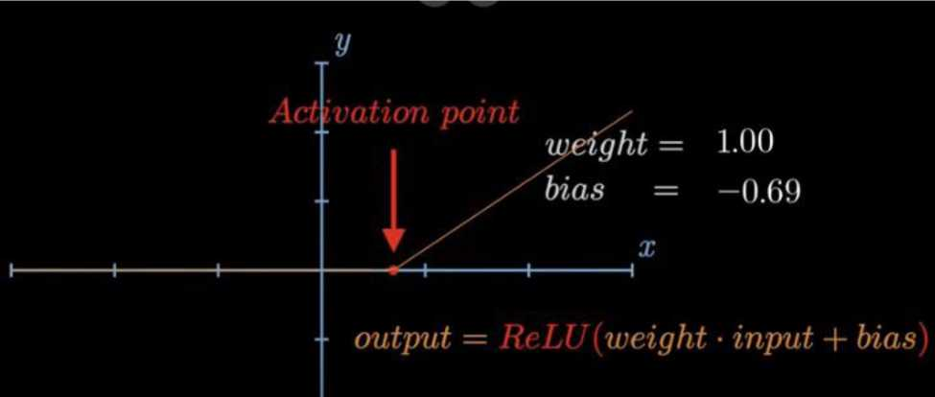
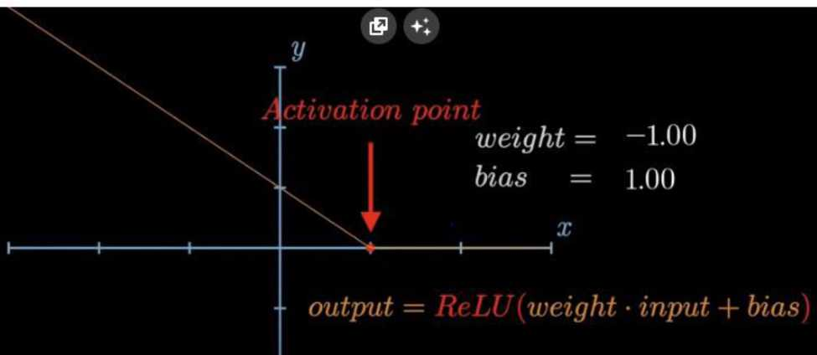
44

Slide 45
Neural Networks from Scratch - P.4 Batches, Layers, and Objects_
1 inport numpy as np
y
3 inputs = [1, 2, 3, 2.5]
4 weights = [[0.2, 0.8, *0.5, 1.0],
5 [0.5, 0.91, 0.26, 0.5],
6 [0.26, -0.27, 0.17, 0.87]]
7
8 biases = [2, 3, 0.5]
9
0 output np.dot(weights, inputs) biases
1 print(output)
Batch:Helps in generalisation The choice of batch size in deep learning is a hyperparameter that can significantly impact the training process of a neural network. Batch size refers to the
45

Slide 46
number of training examples utilized in one iteration. During each iteration (or epoch), the neural network processes a batch of training samples before updating its weights. The batch size is one of the key factors that affect the model's performance and training dynamics. Here are some considerations regarding batch size:
46

Slide 47
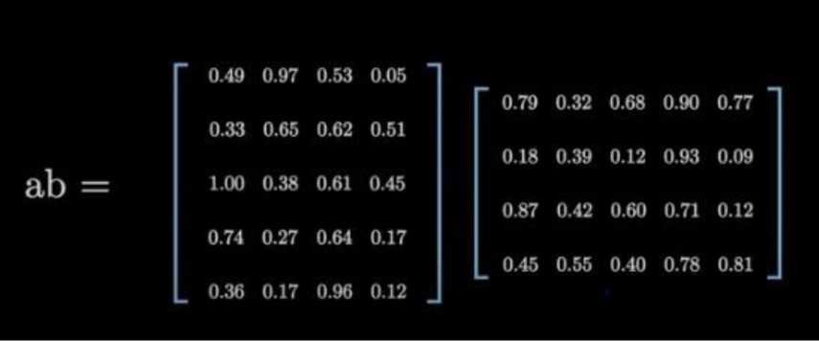
 | numpy np
inputs | m. 2. 3, 2.5) | t i a 1
 | L/.o, S.o, l.l t 1.5. 2.7, 3.: | * t # 3, 0.8))
weights | [[0.2, 0.8. O 10.5, 0.91, ( l 0.26, 0.27, | .5, 1.0). 3.26, 0.5 , 0.17, 0. | ), 87)1
biases | 12. 3. 0.5)
i output np.dot(weights, print(output) |  | Inputs) | biases
Batch/List of lists
MATRIX
47

Slide 48
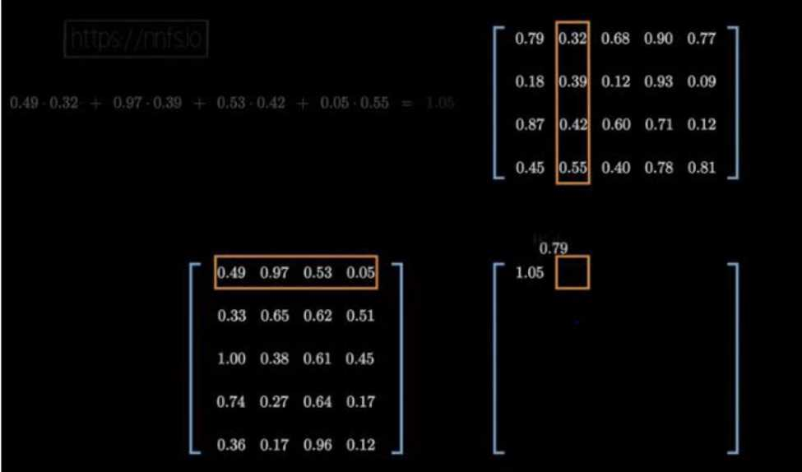
In our case multiplication not possible
48

Slide 49
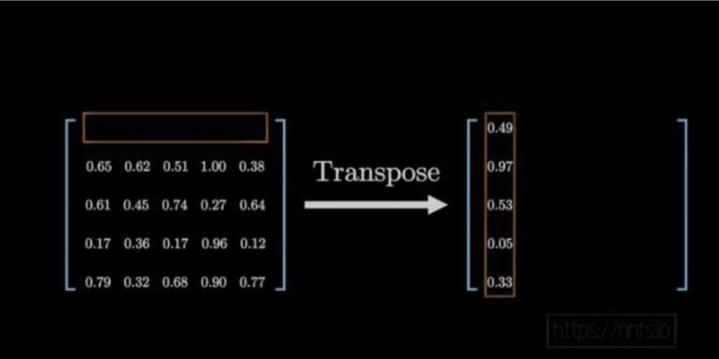
numpy np
inputs I ft, 2, 3, 2.5],
12.0, 5.0, 1.0, 2.01,
[ 1.5, 2.7, 3.3, 0.81]
weights [[0.2, 0.8, 05, 1.0],
[0.5, 0.91. 0.26, 0.5],
[ 0.26, 0.27, 0.17, 0.87]]
biases [2, 3, 0.51
output np.dot(inputs, weights)) biases
print(output)
iceback (most recent call last):
:ile */home/h/0esktop/nnfs/p4.py", line 13, in <module> output = np.dot(inputs, weights) + biases
:ile *<_array function_ intemals>*, line 6, in dot
.ueError: shapes (3,4) and (3,4) not aligned: 4 (dim 1) !■ 3 (dim 0) inished in 0.2s with exit code 1]
i»d: [’/usr/bin/python3.7', '-u‘, ’/home/h/Desktop/nnfs/p4.py' ] ] ir: /home/h/Desktop/nnfs]
ith: /home/h/.local/bin:/usr/local/sbin:/usr/local/bin:/usr/sbin:/usr/bin:/sbin:/bin:> ■al /oame«i:/snan/hinl
To make it possible we will transpose
49

Slide 50
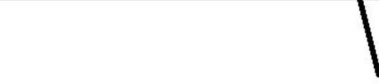
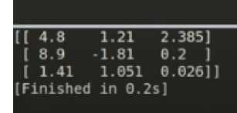
numpy np
inputs [(1, 2. 3, 2.51,
(2.0, 5.0, 1.0, 2.0J,
( 1.5. 2.7. 3.3, 0.8)1
weights ([0.2, 0.8, 0.5, 1.0],
(0.5, -0.91, 0.26, 0.51,
( 0.26, 0.27, 0.17, 0.87))
biases (2, 3. 0.5]
output np.dot(inputs, np.array(weights).T) print(output)
biases
Transpose
Why do we have to transpose
inputs = [1.0, 2.0, 3.0, 2.5]
weights = [[0.2, 0.8, -0.5, 1.0],
[0.5, -0.91, 0.26, -0.5], [-0.26, -0.27, 0.17, 0.87]]
Weights
0.2 0.8 -0.5 1.0
0.5 -0.91 0.26 -0.5
-0.26 -0.27 0.17 0.87
(3, 4)
Matrix
Neuron 1 ►
Neuron 2 ►
Neuron 3 ►
1.0 2.0 3.0 2.5
Sample
(4.)
Vector
50

Slide 51
inputs = [[1.0, 2.0, 3.0, 2.5],
[2.0, 5.0, -1.0, 2.0],
[-1.5, 2.7, 3.3, -0.8]] weights = [[0.2, 0.8, -0.5, 1.0],
[0.5, -0.91, 0.26, -0.5], [-0.26, -0.27, 0.17, 0.87]]
Weights
Inputs — Batch
Neuron 1
0.2 0.8 -0.5 1.0
1.0 2.0 3.0 2.5
Sample 1 Sample 2
Neuron 2
0.5 -0.91 0.26 -0.5
2.0 5.0 -1.0 2.0
Neuron 3
-0.26 -0.27 0.17 0.87
-1.5 2.7 3.3 -0.8
Sample 3
(3, 4)
Matrix
(3. 4) Matrix
After transpose
1.0 2.0 3.0 2.5
2.0 5.0 -1.0 2.0 -1.5 2.7 3.3 -0.8
(3, 4) Matrix
0.2 0.5 -0.26
0.8 -0.91 -0.27 -0.5 0.26 0.17
1.0 -0.5 0.87
(4, 3) Matrix
2.8 -1.79 1.885
= 6.9 -4.81 -0.3
-0.59 -1.949 -0.474
(3, 3) Matrix
np.dot(inputs, np.array(weights).T)
1.0 2.0 3.0 2.5
0.2 0.5 -0.26
2.8 -1.79 1.885
2.0 5.0 -1.0 2.0
0.8 -0.91 -0.27
= 6.9 -4.81 -0.3
-1.5 2.7 3.3 -0.8
-0.5 0.26 0.17
-0.59 -1.949 -0.474
1.0 -0.5 0.87
51

Slide 52
Adding a bias
-Just adding the row vector bias to each row of matrix
np.dot(inputs, np.array(weights).T) + biases
2.8 | -1.79 | 1.885 |  |  |  | 4.8 | 1.21 | 2.385
6.9 | -4.81 | -0.3 | + [ | 2.0 3.0 0.5 | — | 8.9 | -1.81 | 0.2
-0.59 | -1.949 | -0.474
outputs = np.dot(inputs, np.array(weights).T) >>> array([[ 4.8 1.21 2.385],
[ 8.9 -1.81 0.2 ],
[ 1.41 1.051 0.026]])
+ biases
2.8 | -1.79 | 1.885
6.9 | -4.81 | -0.3
-0.59 | -1.949 | -0.474
+ [
] -
4.8 | 1.21 | 2.385
8.9 | -1.81 | 0.2
1.41 | 1.051 | 0.026
2.0 3.0 0.5
LETS ADD SECOND LAYERS
52

Slide 53
(2.0, 5.C | * » * * ® » | 20],
I 1.5. 2. | ' l 3 3 t | 0-8] ]
weights ((0.2, 0. | Of O . | , 1.0).
(0.5. C | ).91, 0.1 | >6. 0.5],
I 0.26, | " • ¹ * » | J.17, 0.87]]
biases (2, 3, 0.! | »i
weights2 ([0-1, r n Q c | 0.14, 0 | 5],
i o•c I 0 44, | v» « / 3 , V | . 33 J , J. 1311
biases2 ( 1, 2, | e.sft | _1
Second layer
The following is output of layerl that will be the in put oflayer2
jlay«rl outputs np,dot(inputs, np. or ra:. (weights).T bios
layerl outputs np.dot(inputs, np.array(weights).T) biases
layer2 outputs np.iu’(layerl outputs, np.arrav(weights2).T) biases2 23 print(layer2 outputs)
II 0.5031 1.04185 2.03875)
( 0.2434 -2.7332 -5.7633 )
(-0.99314 1.41254 -0.35655])
(Finished in 0.2s]
53

Slide 54
inputs
nu*py np
lights
bid
lights] (I
tayerl layer? | outputs np.dot(Inputs, np.array(weigh outputs np.dotllayerl outputs, np.arr layer? outputs) | tSt.T) bia ay(welgfits2) | .T) biases?
0.5031 0.2434 | 1.04165 -2.03875] 2.7332 -5.7633 1
0.99314 MUM 0.356551] nlshed in 6.2s)
Let.s convert the layers in object so as to change size
In Python, you can initialize an object by defining a class and creating an instance (object) of
54

Slide 55
that class. Here’s a simple example:
tt Define a class class MyClass:
# Constructor (initializer method}
def __init__(self, attributel, attributed):
ff Set attributes during object initialization self.attributel = attribute! self.attributed = attributed
# Create an instance of the class
my_object = MyClass(attributel.value, attributed,value)
1. Define a Class (MyClass):
• Classes in Python are blueprints for creating objects. They encapsulate data (attributes) and functions (methods) that operate on that data.
55

Slide 56
• The init method is a
special method called a constructor. It is executed when an object is created from the class and is used to initialize the object's attributes.
2. Create an Instance of the Class (my_object):
To create an object (instance) of the class, you call the class as if it were a function, passing the necessary arguments to the init method.
56

Slide 57
The self parameter in the
_init_method refers to the
instance being created. The other parameters (attributel and attribute2 in this case) are used to pass values during object initialization.
2 Define a class class Person:
# Constructor
def __init_.(self, name, age):
U Set attributes during object initialization selt.name = name selt.age = age
# Create an instance of the class personl = Person( ’Alice", 30)
# Access object attributes
print(personi.name) ft Output: Alice print (person!, age) ft Output: 30
In this example, Person is a class with attributes name and
57

Slide 58
age, and personl is an instance of the Person class initialized with specific
Let change the in put data to X
X [[1. 2. 3, 2.51,
{2.0, 5.0, 10, 2 0|,
[-1,5, 2.7. J_{r}J, OS]]
Initializing the layer
There are two ways we can initialize a layer
• Train a model that you
have save
58

